Slide 1
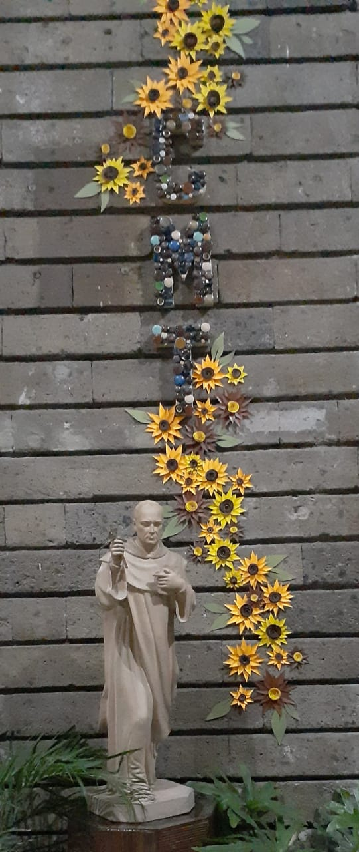
embracing THE MYSTERY OF THE CROSS

Slide 2
Offering you on this evening of Good Friday a recreated Way of The Cross: deep, right from the heart of life, which is the heart of God. Do not worry about the order or traditions or forms, let the Holy Spirit lead you at this moment and teach you how to caress from the heart.

Slide 3
"Crucified is innocence in the face of the perversity of the ruthless, crucified are the hopes of those who dared to go into the depths of life. Crucified the truth in the name of what is convenient.
Crucified over and over again, the justice under the oppression of corruption and abuse of power. Crucified love because of selfishness, pride or pleasure, indifference, fear, mediocrity, deceit.
They... the crucified of history, of the way, of the peoples. The anonymous and silenced, those who do not count for their lives. Crucified people who cry out to us "Let us live"...
Shouts that tear the sky apart and often only find the echo of the helplessness of their own silent pain.”

Slide 4
Tears are part of the embrace, the caress. Don't be afraid to cry, or to yearn. Don't suppress grief or disguise absence. Just try to believe, even today, that the last word belongs to Life, even if it hurts now.
The memory, which at times burns, will be tinged with gratitude when the pain fades; a gratitude for their life, for their presence, for their footprint.
But do not be in a hurry, do not want to force the time when we all need space for mourning. A day of resurrection will come, when all will be well.
Now we are left with love, tenderness, caresses, which cannot be silenced even by death.

Slide 5
To caress is typical of an enlarged heart, of the one that is touched from within, of the one that is capable of crying in the depths, of embracing every orphanhood and of loving without any further ado, of the one that has learned to heal its own wounds and to give himself without fear to all who need him.

Slide 6
“A cry of horror awakened me: “My Father, my father, I am drowning!” …
At once I heard the Father’s voice which said: “Go, quickly. My daughter is drowning.”
MR 1,23
1st EMBRACe

Slide 7
Caress the pain of this Christ, of so many mothers and grandmothers who are looking for their missing children and grandchildren, because of drug trafficking, drug smuggling, human trafficking and "settling of scores".
DISAPPEARED
Caress Christ: their pain, their desperation, their fight.
What do they feel? What do they need?
INTERCEDE FOR THEM AND EMBRACE THEM.

Slide 8
“It hurts me, I'm desperate and at the same time I ask God to give him strength. I dream that my daughter is alive, that I see her with a child, that calls me 'mommy, I´m here. I keep dreaming that she is alive.”
"We dug the earth with our own hands, hoping to find them. We bled in pain but it is only the bleeding of the soul. Whoever we find is a triumph, they are all our children, they are all gone.”
"In many cases the police find people in mass graves and then rebury them in others; it is a double disappearance. It's a double pain. It is a double impotence."
"We have asked many people for help but they are all afraid, they don't want to get involved. I just think that if "they were your children or grandchildren" they would forget about the fear and would go out and look for them. We are also afraid but we don't have time for that.They need us and we want to find them alive if we can. They are ours, not the mafia's.”
"We are here in an act of rebellion, in an act of demanding justice because we are tired of waiting for justice to be done for our children (...) because it is the same to die riddled with bullets in the street, as our comrades who have lost their lives for raising their voices, as to die here in an act of love".
I found him dismembered, sent to me in little pieces. I put each of its parts together like the pieces of a puzzle. He was missing a hand. How could there be so much wickedness? What did I do wrong as a mother? What did I fail at?

Slide 9
CARESS THEM THROUGH YOUR PRAYER,
EMBRACE THEM, COMFORT THEM.
Our Father…
Glory…

Slide 10
Take care of her – the militant – wipe away her tears, console her in her afflictions, soothe her sorrows; all that you do for her on earth, she will return and do for you in heaven.
(MR 1,31)
2nd EMBRACe

Slide 11
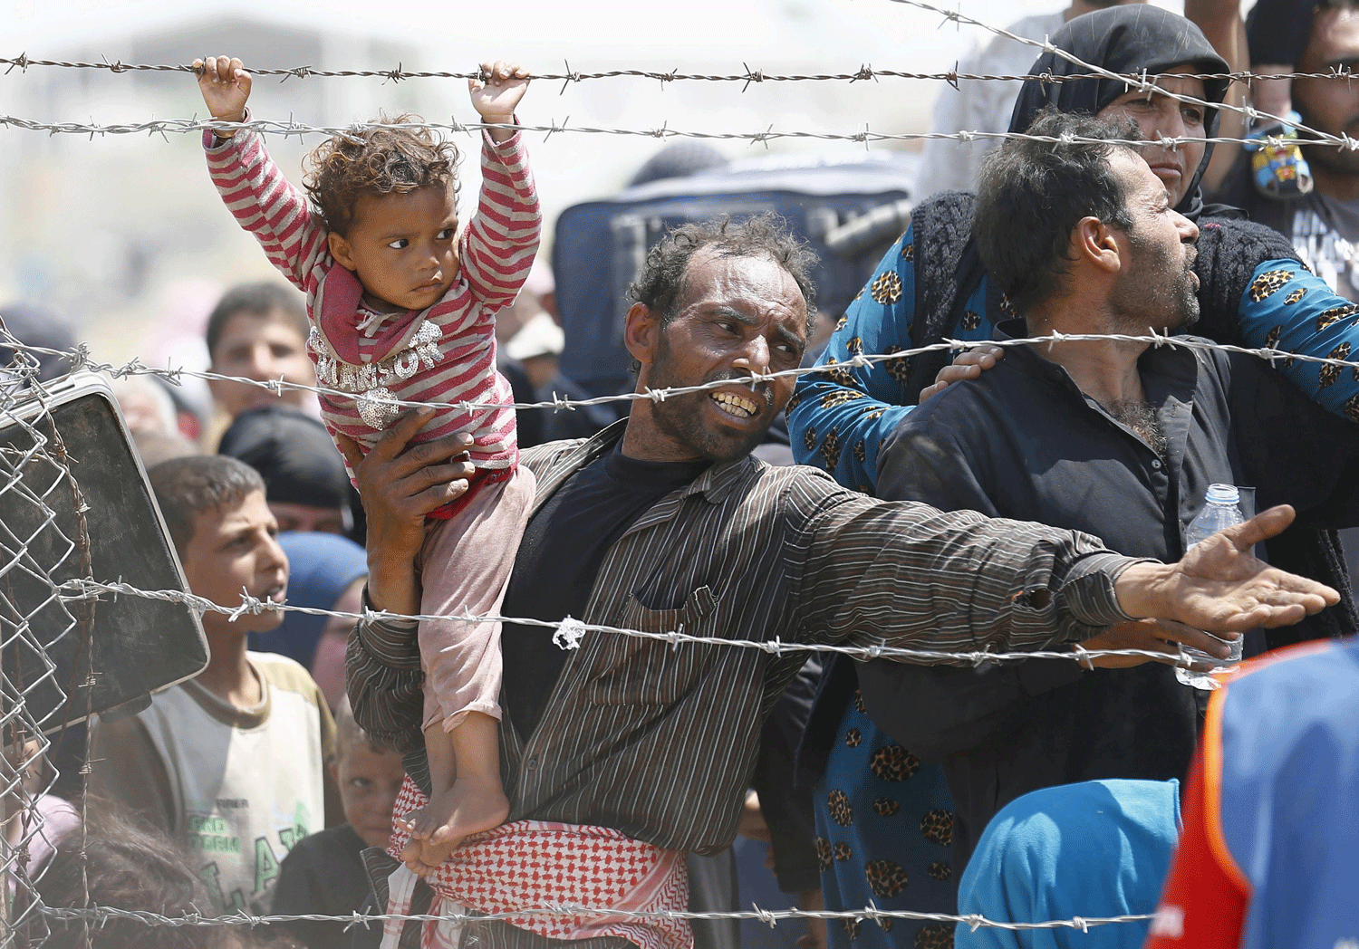
CARESS Christ in the pain, the helplessness, in the destitution and the uncertainty of so many migrants and refugees, of those who die at sea, of those who are killed at the borders.
Caress their pain, their desperation, their fight.
What do they feel? What do they need?
INTERCEDE FOR THEM AND EMBRACE THEM.

Slide 12
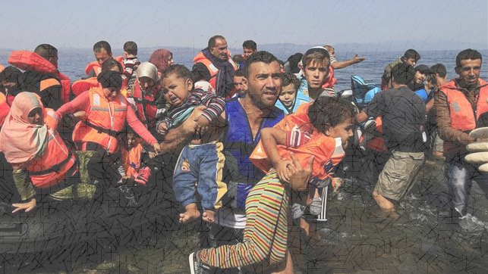
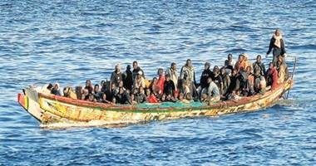
"There's no room to stretch, leaning on our backs it's raining without shelter, we squeeze the wool of the blankets. Night of patience, the sea travels with us, At dawn the horizon sinks into the pockets of the waves. In the human mass that we form with the women in the center, a child dies in his mother's arms. Perhaps it is the best of luck, an end in the lap, he is lowered into the waves with a quiet song. The sea wraps the fallen leaf in a roll of foam”.
Our children, travelling acrobats, clowns, witches, little soldiers.
Nothing is enough for them too, they sleep in the storms with their thumb in their mouths as dinner.
“Some hands have held me, northern customs.
Plastic gloves and masks in the mouth.
They separate the dead from the living, this is the harvest of the sea. Thousands of us locked up in place for a hundred... We are neither milk nor meat.
We are work. They don't want us and that's it."
(Erri de Luca)

Slide 13
CARESS THEM THROUGH YOUR PRAYER,
EMBRACE THEM, COMFORT THEM.
Our Father…
Glory…

Slide 14
She shouted with horror: Father, my Father! and she disappeared. This time she was very young, hardly twelve years old. I saw her very obscurely, covered with her veil. After this I had such great desires to die in defense of that beautiful Child, that if Providence had not saved my life by a miracle, I would have succeeded in my desire.
(MR VII,3-4).
3rd EMBRACe

Slide 15
Caress and embrace Christ in the despair and fear of so many victims of human trafficking.
Embrace their violented, outraged and wounded bodies, embrace their broken dreams.
Intercede for them, cry out to heaven for their release.

Slide 16
"Thank you for coming for us, they were going to kill us, after destroying us and hurting us so much... this is a nightmare, hell, disgust. There are more children downstairs ( pointing out where)... you think? On weekends and holidays the business grows. For the full service and pre-payment of any of this floor (young people between 14 and 17 years) took 24 hours free of everything below ( children up to 7 years) ... (sex and group or individual rape, torture with beatings and electricity to start with) . They are monsters... in the course of the night they have already destroyed many, the cry of the little ones is desperate, we have already become used to it or anesthetized. Drugs help. The only food is sex, the only pillow is a pig's lap. God, Santa or the elves heard us, they could not leave us here any more, we were all going to die, at this time even some or many, they pay for the service with corpses, they like it. It's a miracle... I can't believe it yet... they, and point to the children, are my family, here the invisible ones are all family, we have no more family than each other... and it hurts to see the family die and suffer and not be able to do anything because you are the same or worse than them...
There are many of us, but no one cares about us. Everyone is afraid, the neighbours are afraid and look the other way, people know we exist but prefer to let "others handle it". And that other one never comes.. Every day becomes an agony. I have been kidnapped for 7 years, since I was 4, I had already lost hope. I don't know what my real name is, nor where I come from" ( He breaks down in tears and doesn't speak anymore, he is dying, we are late).

Slide 17
CARESS THEM THROUGH YOUR PRAYER,
EMBRACE THEIR WOUNDS, COMFORT THEM, TELL THEM NOT TO LOSE HOPE.
Our Father…
Glory…

Slide 18
Oh, fair Virgin, as you did not accept my blood, then, accept my tears now, a heart consumed with pain and sorrow.
What else can I do for the Church?
(MR 1,29).
4th EMBRACe

Slide 19
Caress their pain, their desperation, their fight.
What do they feel? What do they need?
INTERCEDE FOR THEM AND EMBRACE THEM.
Caress and accompany Christ in so many victims of the virtual trap, of those who have lost everything in it, even their lives, for the disappeared and persecuted of this time, for those who do not know "that they are sick”.

Slide 20
"When I heard news like this, I thought it was only for children, that adults like me would distinguish very well what´s true and what´s false. But it wasn't like that. Or maybe I saw it but didn't want to recognize it. It was trapping me, de-stressing me, it was relaxing me.
It all started with that game; every challenge made me feel powerful and free. And in reality, I felt like a failure. But day by day I got deeper into it without realizing it, until "the other side" already knew everything about me. And the threats and extortion began.
I lost my job, my bank account and the whole family's savings were emptied, my wife left me to protect my children (I don't blame her, my daughter was almost killed for my mistake and how many other things would have been done to her before she was killed).
I ended up in prison, and here I am serving my sentence for killing a man in "the final challenge of the game". I was supposed to feel invincible at the end of the game, but in reality I feel stupid. I lost everything. I lost my family."
"My mom had told me to be responsible, to be careful who I chatted with. I wish I had listened to him.
But I didn't. I met a guy in a dating app, fell in love at first sight. I didn't have reason to be afraid of him because he was loving, caring, close. He wondered and cared about me more than my mom and my friends.
One day I ran away from school and we decided to meet. He never came, or if he did I don't know because I don't remember what happened. I just woke up in a horrible place. I had already been bought and my "owners" were waiting for me. It took me 6 years until I could escape.
Shattered and disfigured. They burned my face when I tried to escape. I've never been the sweet young thing I used to be again.”

Slide 21
CARESS THEM THROUGH YOUR PRAYER,
EMBRACE THEM.
INTERCEDE FOR THEM.
WE SING: “Yo te doy lo que soy, lo que tengo y quiero y cuando puedo tener”.

Slide 22
“Listen and take notice of the tears and moaning of this, your Daughter.”
( MR 17,4)
5th EMBRACe

Slide 23
Caress their pain, their desperation, their fight.
What do they feel? What do they need?
INTERCEDE FOR THEM AND EMBRACE THEM.
LOOK AT HIM, CONTEMPLATE: WHAT DOES HIS SIGHT SUGGEST YOU?
Embrace Christ in the elders, in their loneliness, sickness and dementia.

Slide 24
"I broke my hip, what am I going to do? I don't want to be a burden to my son. I don't want to leave my home. I can't do it alone. I am distraught."
“"I haven't seen my children and grandchildren in months. No phone calls either. The last time I heard from them was when I was in the hospital. Sometimes I think, if I was admitted again they would come soon and I could see them. I feel very lonely, I miss them. There is a girl who comes once a week to clean and does the shopping but the rest of the time I am alone. I don't know what to do anymore, it's so sad to get old”.
“And who are you? What do you want with me? I have no money, so if you come to steal from me you can go back the way you came" (an old man answers his beloved wife, he no longer remembers her. She cries in silence, the man with whom she has shared 70 years of marriage is no longer the same. She loves him. And suffers in silence)".
"I didn't realize. Because of work, children, friends, meetings, I didn't have time to go visit him. He died alone and that is a huge burden for me. If I could turn back time I would convince my partner to come and live with us. I would tell him that I love him, I would fill him with kisses, I would thank him for all his sacrifice for me and my brothers.

Slide 25
CARESS THEM THROUGH YOUR PRAYER,
EMBRACE THEIR LONELINESS, COMFORT THEM IN THEIR SICKNESS.
Our Father…
Glory…

Slide 26
“What do you want, my Daughter, what do you want? Your sighs, your tears, your cries and prayers have reached my ears; ask and I will give you whatever you ask.” (MR 8,26).
6th EMBRACe

Slide 27
CARESS CHRIST IN THOSE WHO DON´T FIND THE MEANING OF THEIR LIVES, IN THOSE WHO ARE OVERWHELMED AND STUCK IN THEIR PAIN, IN THOSE WHO DAY BY DAY ARE DYING BY SUICIDE AND LONELINESS.
Caress their pain, their dispair, their fight.
What do they feel? What do they need?
INTERCEDE FOR THEM AND EMBRACE THEM.

Slide 28
"When his wife cheated on him, his world fell apart. He no longer had anything to live for or fight for. He started drinking, he walked away from everyone. He quit his job, went into debt and dug "his own grave". We found him in the house, there was nothing left to do. He had a lot of things to do, to live for. But his broken heart of love blinded him to reality. We didn't know how to help him either.
"I'd been feeling like the "weirdo" of the family for months, I didn't fit in with their way of thinking or living. I loved them and they loved me, but we didn't accept each other or we just didn't know how. I didn't feel loved, everything was going wrong, nothing I wanted was going right. I was never going to be the "success" they expected me to be. And I just jumped, I wanted to disappear. But it went wrong and I'm still alive. Sometimes the same ideas come to me, we still don't understand each other. But I'm learning to survive with it. I still need help but I have no one to talk to.
"Mom, I don't want to do this, but I can't live anymore. I don't want him to hurt me anymore, I'm afraid. Because I want to live is that I do this, at least this way He will not be the one to kill me and cause me no more pain. Sorry, Mom. I love you. I can't do anything else.”

Slide 29
CARESS THEM THROUGH YOUR PRAYER.
EMBRACE THEM. TELL THEM THEY STILL HAVE OTHER OPPORTUNITY.
Our Father…
Glory…

Slide 30
“…terror and horror took hold of my soul.” ( MR 19,1)
7th EMBRACe

Slide 31
Caress their pain, their dispair, their fight.
What do they feel? What do they need?
INTERCEDE FOR THEM AND EMBRACE THEM.
Caress Christ in all the people infected with COVID-19, in those who have died far from their loved ones, in all the staff who are breaking their back in hospitals and on the streets to stop this pandemic.

Slide 32
Think about them.
Intercede.
CARESS THEM THROUGH YOUR PRAYER.
EMBRACE THEM.
TELL THEM TO BE STRONG, TELL THEM THAT TOGETHER WE WILL WIN.
Our Father…
Glory…

Slide 33
“I was searching for solitude, but the form and sight of that young woman followed me shouting in horror: “My Father, my father, do not leave me in the power of those cruel, bloodstained beasts!” At the sound of my daughter’s shouts I took heart, strength and courage.”
( MR 14,2).
8th EMBRACe

Slide 34
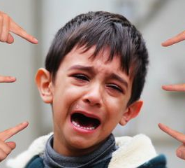
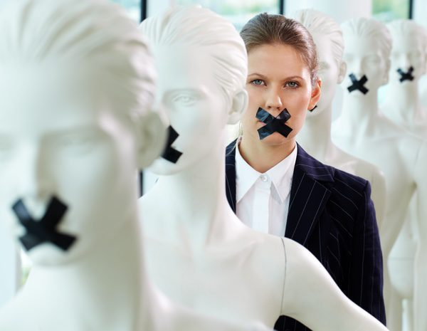
Caress their pain, their dispair, their fight.
What do they feel? What do they need?
INTERCEDE FOR THEM AND EMBRACE THEM.
Caress Christ in the pain of these people, in the bullying that many children suffer, in those who are discriminated against because of their disability, in women who suffer abuse and violence simply because they are women, in those who are persecuted and stoned because of their sexual condition.

Slide 35
"I never reported it because I was afraid, I had just arrived at the service and I didn't know if I was going to be renewed or not. I needed the job, I had to pay for treatment and medicine for my son with leukemia. I worked overtime in droves, quietly accepting his obscene jokes because I really needed the job. Sometimes he touched me and laughed, and made fun of me for the way I dressed.
One day I refused to have sex with him. He just fired me and didn't compensate me. If you say no to closing doors on you, do you have to say yes and accept the humiliations just to get a job? He took advantage of my need.”
"I'm not a bad person and it hurts me that many point their fingers at me. I'm gay and I'm not afraid to say it but I can't shout it out to everyone either because most people don't understand it, on the contrary, it makes them angry. My parents, I think, sometimes prefer me dead than accept that I like men.
This weekend my partner and I were brutally beaten up at the disco for being gay, I survived even though I have a long rehabilitation, but my partner didn't. Why do they judge us for what we are? Why don't they understand that some of us are different? I just want them to leave me alone. I have a right to live, too. Peter had that right too, but it was taken away from him.
"My little boy told me he didn't want to go to class and I treated him like a slob. His grades dropped, he became a withdrawn child. He cried, he wet his bed. I didn't know what was wrong with him and he didn't dare tell me either.
One day I got a call from the school. My boy had been admitted to the emergency room because of a beating by a classmate. Only then did I understand everything. My child had suffered hell for eight months and I couldn't help him. It's not easy to understand.

Slide 36
CARESS THEM THROUGH YOUR PRAYER. EMBRACE THEIR WOUNDS, PHISICAL ONES AND THOSE OF THEIR HEART.
Padre nuestro…
Gloria…

Slide 37
“Oh, my flesh and my whole soul tremble! I see an abyss before me, I see a cavern within me which horrifies me, I see the power to offend you, freedom to oppose you, the possibility of ignoring your will and doing my own; and that power, that possibility, that freedom to follow my own will rather than yours is what frightens me.”
(MR 4,21).
9th EMBRACe

Slide 38
Caress their pain, their dispair, their fight.
What do they feel? What do they need?
INTERCEDE FOR THEM AND EMBRACE THEM.
Caress Christ in your sisters, in the family that we are.
You caress your sisters who are suffering the most, those who are sick, those who are going through difficult times, those who are on special leave.
We are family and we need each other.

Slide 39
Think of the testimony of so many sisters who have contributed to your spiritual growth, who have sustained you in difficult times.
Touch them,
Christ is in them.
Think of those sisters who have hurt you and who today need to offer themselves to God and to forgive. Forgiveness liberates, restores, dignifies.

Slide 40
CARESS THEM THROUGH YOUR PRAYER. EMBRACE THEM. EMBRACE YOURSELF.
EMBRACE US.
WE SING: “Cuanto más te miro, Iglesia…”.

Slide 41
And then the voice of the Father was heard from heaven saying: “This is my beloved Daughter I thank you for encouraging her” [Mt 3,17; Mk 1,11; Lk 9,35]. And the Son added: “This is my beloved Spouse and your Spouse: I thank you for the services you have rendered her.”
(MR 7,6).
10th EMBRACe

Slide 42
Caress their efforts, their fight, their fidelity.
What do they feel? What do they need?
INTERCEDE FOR THEM AND EMBRACE THEM.
Caress Christ and thank him for so many people who fight for truth, justice and the Good, for all those who break their back in their mission, work, family, community.

Slide 43
Remember every one of them who with dedication and effort take care of life and defend it.

Slide 44
CARESS THEM THROUGH YOUR PRAYER. EMBRACE THEM WITH GRATITUDE.
THEY´RE WORTH IT, THEY HAVE GAINED IT WITH THEIR DEDICATION AND FIDELITY.
WE SING: Gracias quiero darte por amarme…

Slide 45
"The more a being carries a wound or limitation, the more that suffering precipitates them into the heart of God. There is always an infinite relationship between the abyss in which a person lives and the tenderness of God. Never will a human being be more wounded by life than he is loved by God".

Slide 46
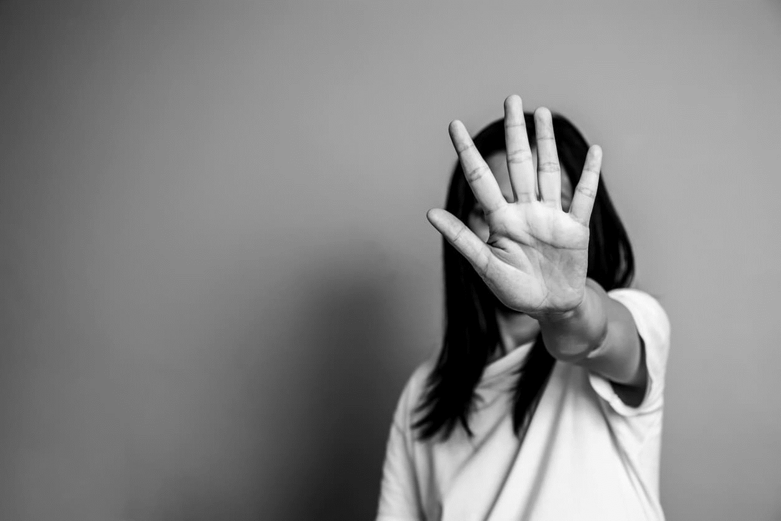
There are many situations in your life, in your family, between your friends, in the society, in the world… that cannot continue as they used to be.
Many situations that ask for truth and justice. One way or another they shout: enough, no more!
A success is not built with lies and masks.
Being what you really are does not make you a failure but rather someone authentic.
ENOUGH!
NO MORE!
DON´T YOU EVER BE AFRAID
TO CALL THINGS BY THEIR OWN NAMES.

Slide 47
"To create "home" in definitive "is to create family; it is to learn to feel united to others beyond utilitarian or functional ties, united in such a way that we feel life a little more human. To create homes, "houses of communion", is to allow prophecy to take shape and make our hours and days less inhospitable, less indifferent and anonymous. It is to weave bonds that are built with simple, everyday gestures that we can all make. A home, and we all know this very well, needs everyone's collaboration. No one can be indifferent or alien, since each one is a necessary stone in its construction. And that means asking the Lord to give us the grace to learn patience, to learn to forgive ourselves; to learn every day to start over. And how many times do we have to forgive or start over? Seventy times seven, as many as necessary. Creating strong bonds requires the trust that is nourished every day by patience and forgiveness. And so the miracle of experiencing that here one is born again occurs, here we are all born again because we feel God's caress at work, which makes it possible for us to dream of a more human and, therefore, more divine world. This is an urgency, a powerful cry of the Church that we build family".

Slide 48
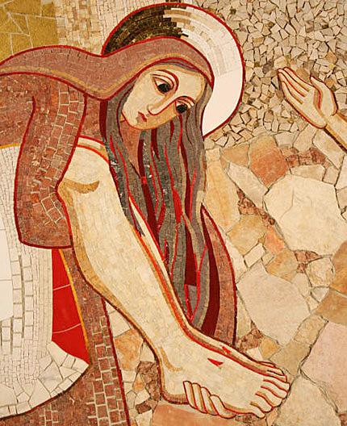
To caress the mystery of the Cross means to build that home and family that humanity needs. That in our mission and charism, is the cry of humanity and the dream of God before so many orphans.
ONLY IN THIS WAY THE CROSS DOES HAVE MEANING...
ONLY THIS WAY WILL THE GOOD HAVE THE LAST WORD.

Slide 49
For the intentions of Pope Francis and those of the whole Church
Our Father…
Hail Mary…
Glory…

